Slide 1
Chapter: File-System Interface

Slide 2
Chapter: File-System Interface
File Concept
Access Methods
Directory Structure
File-System Mounting
File Sharing
Protection

Slide 3
File Management
Process of storing, Controlling, Managing data stored on secondary storage in the form of files.
File Management:
  Ensure consistency of data when multiple users access the files
  Provides measures for file security and protection
File system consists of 2 parts:
  Collection of files
  A Directory structure which organizes and provides all the information about all the files in your system.

Slide 4
File Concept
File is a sequence of bits, bytes, lines, or records, the meaning of which is defined by the file’s creator and user.
Field
Record
File
Data Base
A text file: is a sequence of characters organized into lines and pages.
A source file is a sequence of functions, each of which is further organized as declarations followed by executable statements.
An executable file is a series of code sections that the loader can bring into memory and execute.

Slide 5
File Structure
Fixed Length Records
Records that has been assigned a fixed length.
Consider Record:
All records are of same size
int | 20 char | int | 10 char
Roll No. | Name | Age | Qualification
1 | Ram | 20 | B.Tech
2 | Sham | 19 | B.Tech

Slide 6
File Structure
2. Variable Length Records
Instead of giving fixed size, records are separated by connector.
1, ABC, 20, B.Tch
2, Sham, 19, B.Tech
Variable length records can be converted to fixed length while implementing

Slide 7
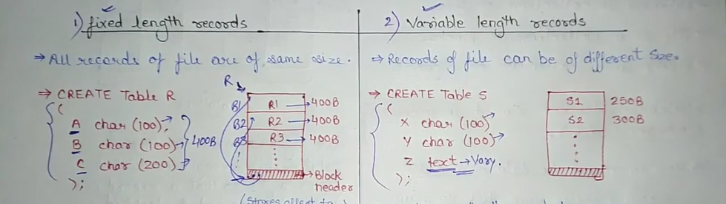

Slide 8
File Structure
None: Sequence or structure of words or bytes
Files contains random records:
a) one line may contain 5 characters
b) other may contain 20 characters
2. Simple Record Structure
a) Lines
b) Fixed length records
c) Variable length records

Slide 9
File Structure
3. Complex Structures
a) Formatted Document : defining start and ending of paragraph
b) Re-locatable load file : There are some instructions with addresses on the basis of which location or relocation to the file is assigned.

Slide 10
File Attributes Data About Data-Meta Data
These attributes will be created automatically once the file is created.
Name – Name is usually a string of characters
Identifier – unique tag (number) identifies file within file system
Type – needed for systems that support different types
Location – pointer to file location on device
Size – current file size
Protection – Access Permissions, controls who can do reading, writing, executing
Time, date, and user identification – data for protection, security, and usage monitoring
Information about files are kept in the directory structure, which is maintained on the disk

Slide 11
File Operations
All operations involve some system calls
Create: using a specific system call. Two steps are necessary to create a file.
a) First, space in the file system must be found for the file.
b) Second, an entry for the new file must be made in the directory.
Read:
  Open a file
  File pointer points to particular record to be read
  Once a record/character is read, the file pointer is increment

Slide 12
File Operations
3. Write:
  Pointer is at the end of the file
  Can be repositioned and is incremented after every write
  File pointer can be repositioned

Slide 13
File Operations
Reposition within file
Delete
Truncate
Open(F_{i}) – search the file F_{i} from the directory structure on disk
Close (F_{i}) – Save / move the content of file F_{i} in memory

Slide 14
Open Files
Several pieces of data are needed to manage open files:
  File Pointer: pointer to last read/write location
  File - Open Count: counter of number of times a file is open
  Disk Location Of The File: From where the is required to be opened, cache of data access information
  Access Rights: per-process access mode information

Slide 15

File Types – Name, Extension

Slide 16
Criteria for File Organization
  Economy of Storage
  There should be minimum redundancy in data
  2. Simple
  3. Maintenance
  4. Reliability
  What kind of reliability is provided for a file
  Unreliable:- if index file is lost / corrupted, actual file may be lost
  Log File: Any record file is a log file

Slide 17
Directory Structure
Symbol table of files that stores all related information about a file it holds with its contents
Directory
F 1
F 2
F 3
F 4
F n
Files
Both the directory structure and the files reside on disk
Backups of these two structures are kept on tapes

Slide 18
Operations Performed on Directory
Directory: collection of files or directories
Directory is basically the Symbol Table that translates file names into their directory entry. Example the phone directory where we are having contact details of each person, Similarly we are having file directory which carries the details of files present in the directory.
Operations:
Search for a file
Create a file
Delete a file
List a directory
Rename a file
Traverse the file system : Search all directories/ sub directories and files

Slide 19

Directory Schemes
Single Level Directory
One directory many files
Entries
Single-Level Directory
Easy to support and understand.
Limitation:
When number of files increases or when the system has more than one user, then Naming problem occurs. All files should have unique names.
Disadvantage:
Difficult to remember the name of files when files increases
Single directory for all users
File names created by different users should be different.

Slide 20

Two Level
2. Two level directory, each user has his own user file directory(UFD). If 10 user than 10 direcories
UFDs have the similar structure, but each lists files of a single user.

Slide 21

Tree Structure
Users can create their sub directories to manage the files.
Tree has Root directory and files have unique file names
users

Slide 22
Paths
Absolute Path: Begins at the root and follows a path down to the specified file giving directory names on the path.
Relative Path: Defines a path from the current directory.
Creating a new file is done in current directory
Delete a file
rm <file-name>
Creating a new subdirectory is done in current directory
  mkdir <dir-name>
Delete Directory:
Empty: rmdir <dir. Name>
Not Empty: rm –r <dir. name?>

Slide 23
Acyclic-Graph Directories
Multiple users can Have shared subdirectories and files
Users have their own working directory and may have one shared directory
Shared subdirectory created by one user in one directory is automatically visible to all users sharing that directory.
Shared directory or file may exist at multiple places simultaneously
Because of sharing, a file may have multiple absolute paths
So different names can refer to same file

Slide 24

Acyclic-Graph Directories

Slide 25
General Graph Directories
Created by adding links to the existing directory
Allows cycles in the same directory
As all files are dependent / linked deleting a main file may harm other files
In case of deletion: Garbage Collection is used
In First Pass: Traversing the entire file and marking everything that can be accessed
In Second Pass: Collect everything that is not marked as the free space

Slide 26
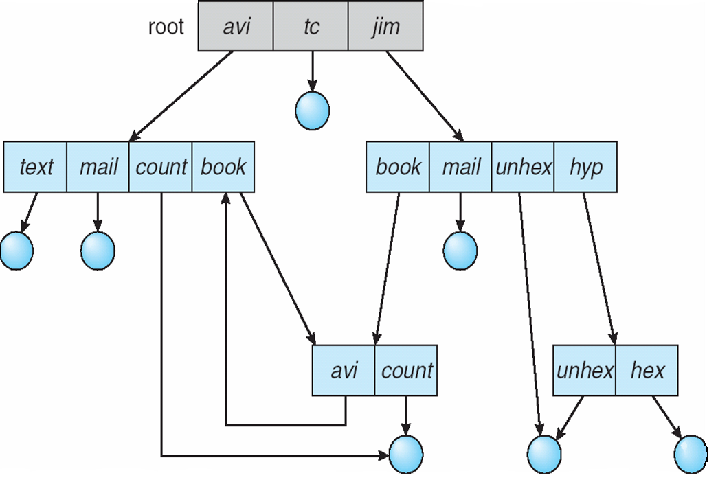
General Graph Directories
There can be cycle in the directory arrangement
General Graph Directory

Slide 27
Directory Implementation
Directories need to be fast to search, insert, and delete, with a minimum of wasted disk space.
1 Linear List
A linear list is the simplest and easiest directory structure
Finding a file requires a linear search.
Deletions can be done by moving all or one entry to vacant position and deleting the pointer.
2 Hash Table
A hash table can also be used to speed up searches.
Implementation is by using Hash value.
(Division/Variant Method)

Slide 28
Chapter 11: Implementing File-System

Slide 29
File System Structure
File System resides on Secondary Storage
Disk provides bulk storage on which a file system resides
To improve I/O efficiency, I/O transfers between memory and disk are performed in units of blocks.
File system has 2 design problems:
  a) Defining How the file system should look to user
  b) Create a algorithm and data structure to map the logical file system to physical file system.

Slide 30
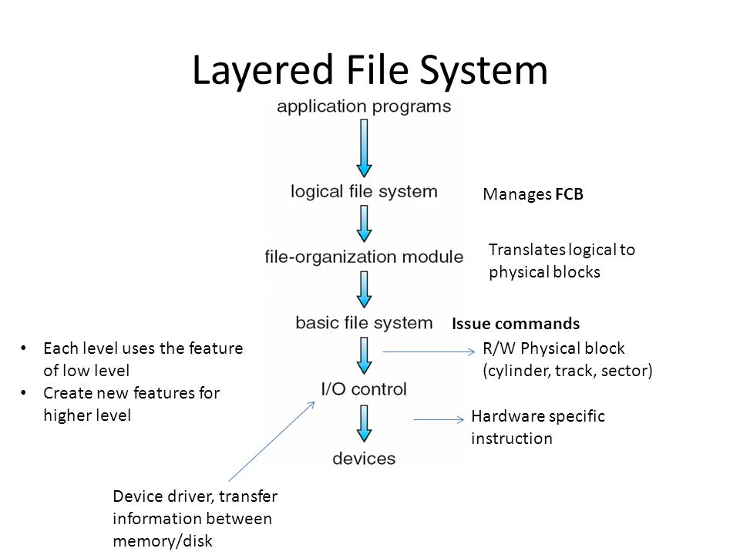
Logical File System contains info. Meta Data, and manages file structure

Slide 31
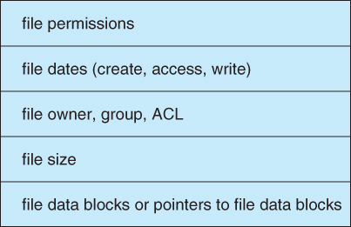
File Control Block

Slide 32
File System Implementation
On disk, file System may contain information about how to boot an OS.
  a) Boot Control Block: Contains info. Needed by the system to boot an OS. This block is empty if there is no OS.
  b) Volume Control Block: Contain partition details:
    No. of blocks in partition
    Size of blocks
    Block pointers etc.
  c) Directory Structure: Used to organize files
  d) File Control Block: Contains info. About file:
    File Permissions
    Modification dates
    File owner, File size and Pointers

Slide 33
File System Implementation
    To Create a new File:
    Application program calls → Logical File System
    Logical File System allocates → New FCB
    System reads appropriate directory from memory
    Directory is updated with → New file and FCB
    New file and FCB is written back to → Disk

Slide 34
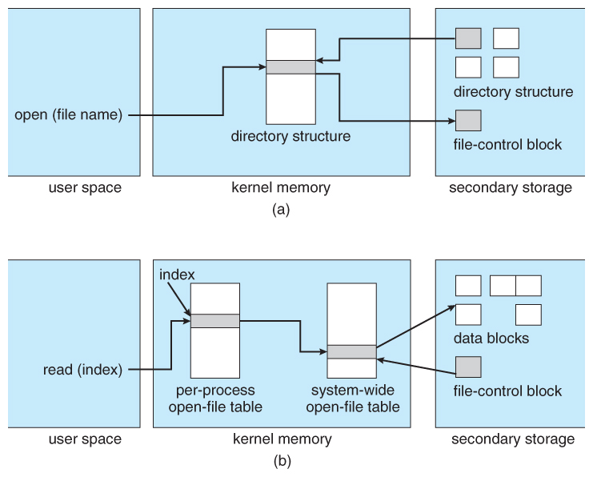
In-memory file-system structures. (a) File open. (b) File read.

Slide 35
File System
It is a part of OS, responsible for controlling secondary storage space.
File system consists of following:
  Access Methods: Manner in which data stored in files is accessed
  File Management: Provide mechanism for files to be stored, shared and secured.
  Storage Management: Allocating space for files on secondary storage devices.
  File Integrity Mechanism: Guaranteeing that file information is not corrupted

Slide 36

Access Methods
1. Sequential Access:
Information of the file is processed in order, one record after the other.
read next: reads a portion of the file (read record) and automatically updates pointer. (move pointer to next location)
write next: Append to end of the file (write and update the pointer.
rewind or reset: to reset the file from beginning

Slide 37
Access Methods
2. Direct Access: Or Relative access
A file is made up of fixed length logical records that allow programs to read and write records rapidly in no particular order.
For Direct Access, File is a numbered sequence of blocks or records.
read n
write n
position to n (jump to record n)
read next
write next
n = relative block number
First Relative Block of file is 0, Second is 1 and so on. Absolute address could be anything.

Slide 38

Indexed Access
Index is created for file.
Index contain pointers for various blocks of a file.
To find the record in the file, search the index and then use the pointer to access the file directly and to find the desired record.
An indexed file is a computer file with an index that allows easy random access to any record given its file key.
The key must be such that it uniquely identifies a record.
A relative file is a file in which each record is identified by its ordinal position in the file

Slide 39
Allocation Methods
Files are stored on disk
Main Issue is: how to allocate space to these files so that disk space is utilized effectively and file can be accessed quickly.
There are three major methods of storing files on disks:
  Contiguous
  Linked
  Indexed

Slide 40
Allocation Methods
1. Contiguous Allocation
Keep blocks of a file together in the continuous memory locations.
Performance is very fast, because reading successive blocks of the same file generally requires no movement of the disk heads.
Storage allocation involves issues:
  first fit, best fit , worst fit etc
Contiguous allocation of a file is defined by the disk address and length of first block.

Slide 41
Contiguous Allocation
If file is n blocks long and starts at location b, the it occupies:
b , b+1, b+2, ……. , b+n-1 locations
Directory entry for each file = Address of the starting block and length of area allocated.
Best suited:
For Sequential Access: File system remembers disk address of the last block referenced and reads next block when required.
For Direct Access: Direct Access to block i of a file that starts at block b, block b+i can be accessed immediately.

Slide 42
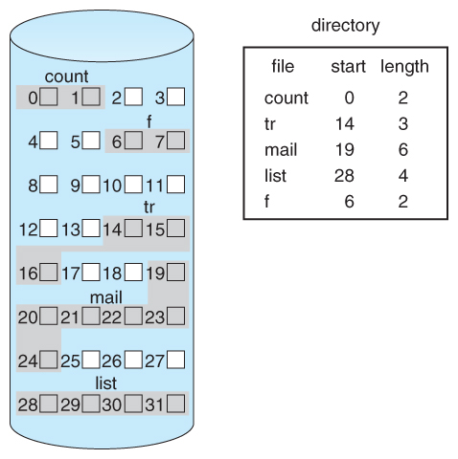
Contiguous Allocation
Problems can arise:
  Finding space for a new file
  When files grow
  if the exact size of a file is unknown at creation time
  Suffers from problem of external fragmentation.
  Difficult to know how much space is needed for a file
  Alot of space becomes unusable before the file fills the space

Slide 43
Linked Allocation
Each file is a linked list of disk blocks
Disk blocks can be scattered any where in disk
Directory contains a pointer to first and last block of the file.
Exp: if file of 5 blocks might start at block 9, continue at block 16, then block 1, block 10 and finally block 25.
Each block contains a pointer to next block.
If each block is 512 bytes and disk address requires 4 bytes then user see block of 508 bytes
To create a new file , create a new entry in directory
Each directory has a entry has a pointer to first disk block of file.
Pointer is initialized to NIL and size / data part is set to 0

Slide 44
Linked Allocation
Disk files can be stored as linked lists
Linked allocation does not require pre-known file sizes, and allows files to grow dynamically at any time.
Drawback
It is efficient for sequential access files
To find ith block of a file, we must start at the beginning of that file and follow the pointers until we go to ith block.
Requires extra space for pointers
Problem with linked allocation is reliability:
  If a pointer is lost or damaged

Slide 45
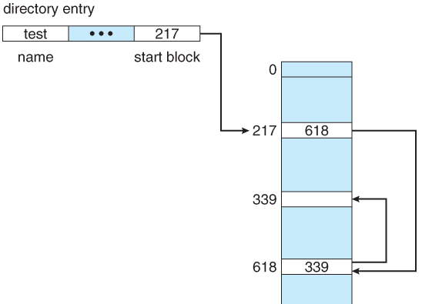
File Allocation Table
Used by DOS
It is a variation of linked allocation
All the links are stored in a separate table at the beginning of the disk.
The benefit of this approach is that the FAT table can be cached in memory, and improving random access speeds.

Slide 46
Indexed Allocation
Indexed Allocation combines all of the indexes for accessing file in a file.
Create a table of indexes
Index file contains pointers to blocks.
Bring all the pointers together into one location : Index Block
Each ith entry in index block points to ith block of the file
Create index of linked locations
Indexed allocation support Direct Access.
  Any free space on the disk can be used for allocation
  Removes external fragmentation

Slide 47
Indexed Allocation
Advantages:
  Any free space on the disk can be used for allocation
  Removes external fragmentation
Disadvantages:
  If index block is small, it will not be able to hold enough pointers
  Entire index will have to be kept in main memory to make it work

Slide 48
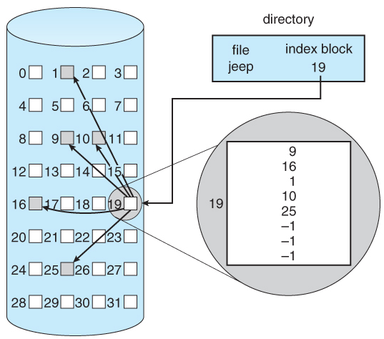
Indexed Allocation

Slide 49
Approaches to implement Index Block
Linked Scheme - An index block is one disk block, which can be read and written in a single disk operation.
For large files several indexes can be combined and maintained
The first index block contains:
  Header information
  First N block addresses
  Pointer to linked index blocks.
Multi-Level Index -
index block contains → pointers to secondary index blocks → which further contain pointers to the actual data blocks.

Slide 50
Approaches to implement Index Block
Combined Scheme -
pointers provide access to more data blocks
The advantage of this scheme:
  for small files the data blocks are readily accessible

Slide 51
Free Space Management
Process of looking after and managing unused blocks of disk
Os maintains free space list: which records all blocks that are not allocated to any file
Methods to implement free space list:
Bit Map or Bit Vector
Linked List
Grouping
Counting

Slide 52

Methods to implement free space list
Bit Map or Bit Vector
Each block is represented by a bit
If block is free, bit is set to 1 otherwise 0

Slide 53

Linked List
Linked list of all the free blocks is maintained
First free block in the list can be pointed by the head pointer
Disadvantage: Traversing is time consuming

Slide 54
Grouping
Grouping
Maintained using linked list
Reserve few disk blocks for management
Modify linked list to:
  store address of next free blocks
  A pointer to next block that contains free block pointers
In this address of n free blocks is stored in the first free blocks
Counting:
This method keeps the address of first free block and number of free contiguous blocks that follow the free block,
(X100 + 10 free blocks)

Slide 55
Mounting
Mount: Mounting makes file systems, files, directories, devices and special files available for use and available to the user.
Process that instructs the OS that a file system is:
  ready to use
  associates it with a particular point in the overall file system hierarchy
  sets options relating to its access
  Example- In C Drive we are having turboc and if we want to use the turbo c in D drive then we need to detach it from d drive and attach it in c drive For implementing this we use the concept of mounting. So OS is amking available turbo c file system to d drive file system.

Slide 56
File Sharing
Sharing of files is required for multi – user system
Sharing may be done through protection scheme
Multiple users:
User ID’s: identify users , assign permissions to the user
Group ID’s: allow users to be in groups , and assign group access rights

Slide 57
File Protection
Protect information against unauthorization
Access Control
Permissions:
Read
Write
Execute
Chmod 777 filename
2. Password Protection

Slide 58
File System Mounting
A file system must be mounted before it can be accessed
A unmounted file system (i.e. Fig. 11-11(b)) is mounted at a mount point

Slide 59

(a) Existing. (b) Unmounted Partition

Slide 60

Mount Point

Slide 61
File Sharing
Sharing of files on multi-user systems is desirable
Sharing may be done through a protection scheme
On distributed systems, files may be shared across a network
Network File System (NFS) is a common distributed file-sharing method

Slide 62
User IDs identify users, allowing permissions and protections to be per-user
Group IDs allow users to be in groups, permitting group access rights
File Sharing – Multiple Users

Slide 63
File Sharing – Remote File Systems
Uses networking to allow file system access between systems
  Manually via programs like FTP
  Automatically, seamlessly using distributed file systems
  Semi automatically via the world wide web
Client-server model allows clients to mount remote file systems from servers
  Server can serve multiple clients
  Client and user-on-client identification is insecure or complicated
  NFS is standard UNIX client-server file sharing protocol
  CIFS is standard Windows protocol
  Standard operating system file calls are translated into remote calls
Distributed Information Systems (distributed naming services) such as LDAP, DNS, NIS, Active Directory implement unified access to information needed for remote computing

Slide 64
File owner/creator should be able to control:
  what can be done
  by whom
Types of access
  Read
  Write
  Execute
  Append
  Delete
  List
Protection

Slide 65
Access Lists and Groups
Mode of access: read, write, execute
Three classes of users
RWX
a) owner access 7 ⇒ 1 1 1
RWX
b) group access 6 ⇒ 1 1 0
RWX
c) public access 1 ⇒ 0 0 1
Ask manager to create a group (unique name), say G, and add some users to the group.
For a particular file (say game) or subdirectory, define an appropriate access.
owner
group
public
chmod
761
game
Attach a group to a file
chgrp G game

Slide 66

A Sample UNIX Directory Listing

